Slide 1
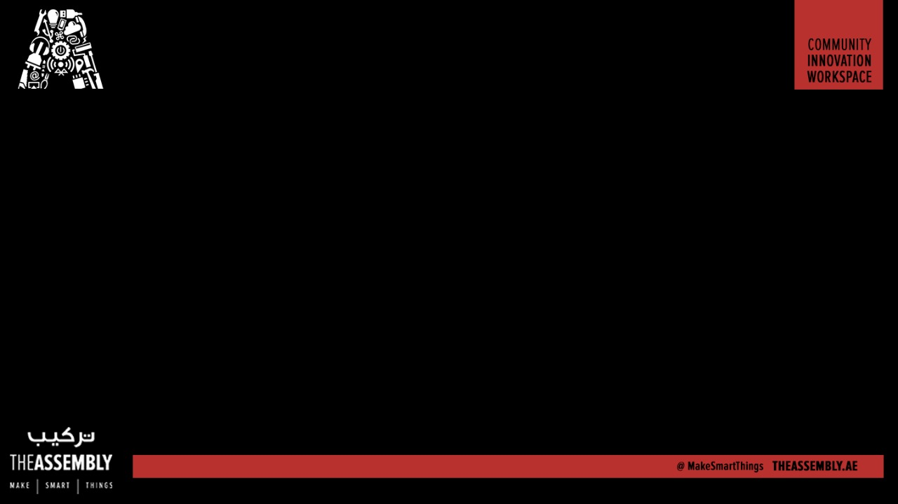
Use voice search to make a video Playlist
Presented By : The Assembly Team

Slide 2
Introduction
OBJECTIVE: Create a voice controlled YouTube playlist generator app that runs on a Raspberry Pi.
The user inputs artist name or keywords using the microphone; the app searches for and retrieves songs based on this criteria and then queues them for instant playback as an fully navigable, embedded YouTube playlist on a web page.

Slide 3
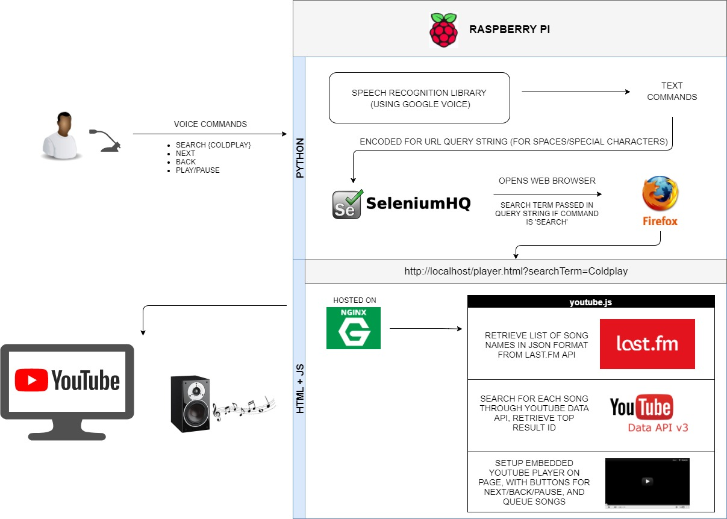

Slide 4
Github repository
To get the instructions and other files go to:
https://github.com/The-Assembly/Voice_recognition_Youtubeplaylist

Slide 5
HTML + Javascript

Slide 6
Building the player webpage
This page receives a search term in the URL query string and creates the embedded playlist based on that criteria. Playback commences on page load.
The page runs on a local webserver (NGINX) on the Raspberry Pi
Code for this portion can be found in the Github repository under the directory RPIVideoPlayer
player.html
js\youtube.js
css\bootstrap.min.css
The contents of this folder should be copied to the html folder used by NGINX (usually /var/www/html)
Acknowledgement: Javascript code modified from work done on Mixbla.st project

Slide 7
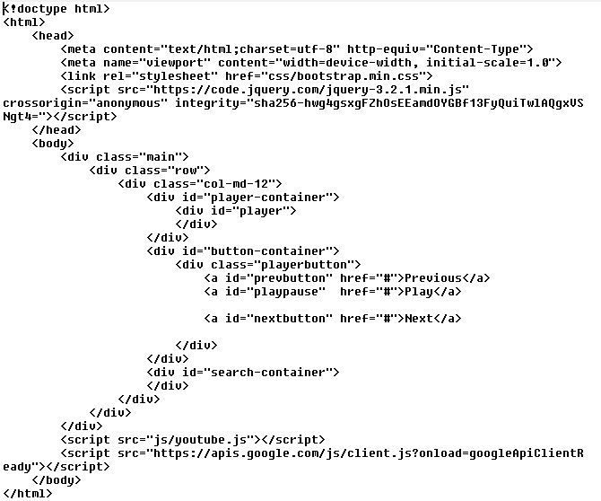
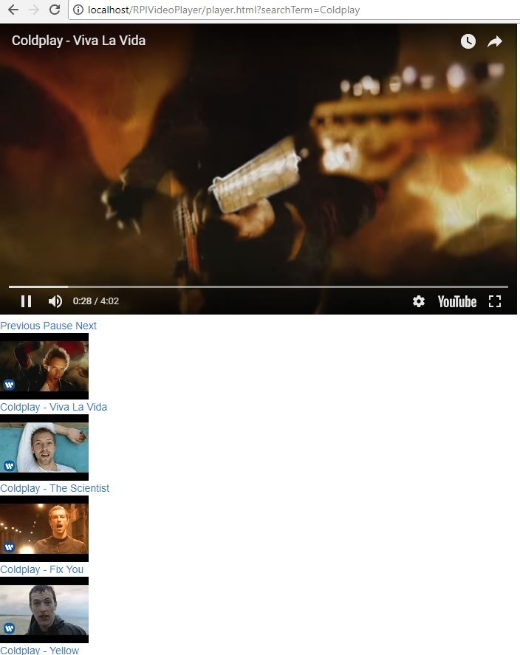
player.html

Slide 8
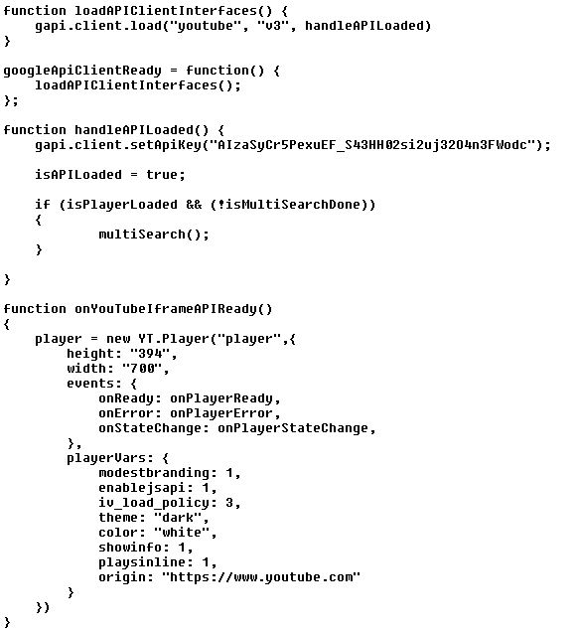
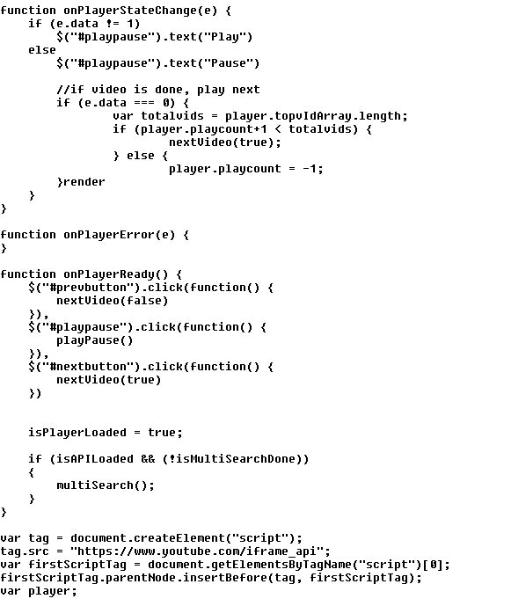

JS: Loading the YouTube apis
YouTube Data API and embedded YouTube player iFrame need to BOTH be loaded before starting multisearch

Slide 9
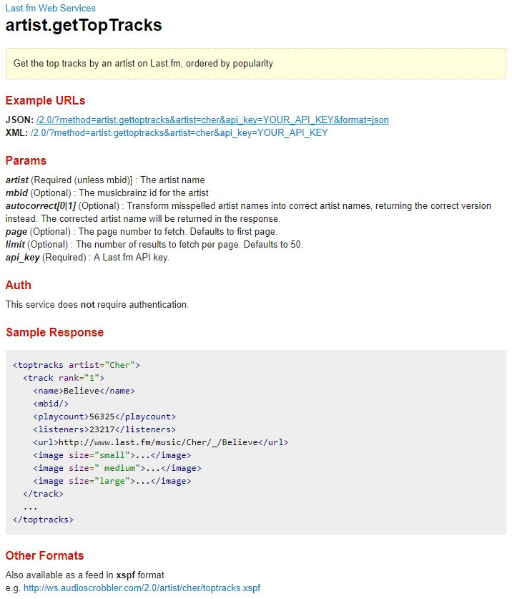
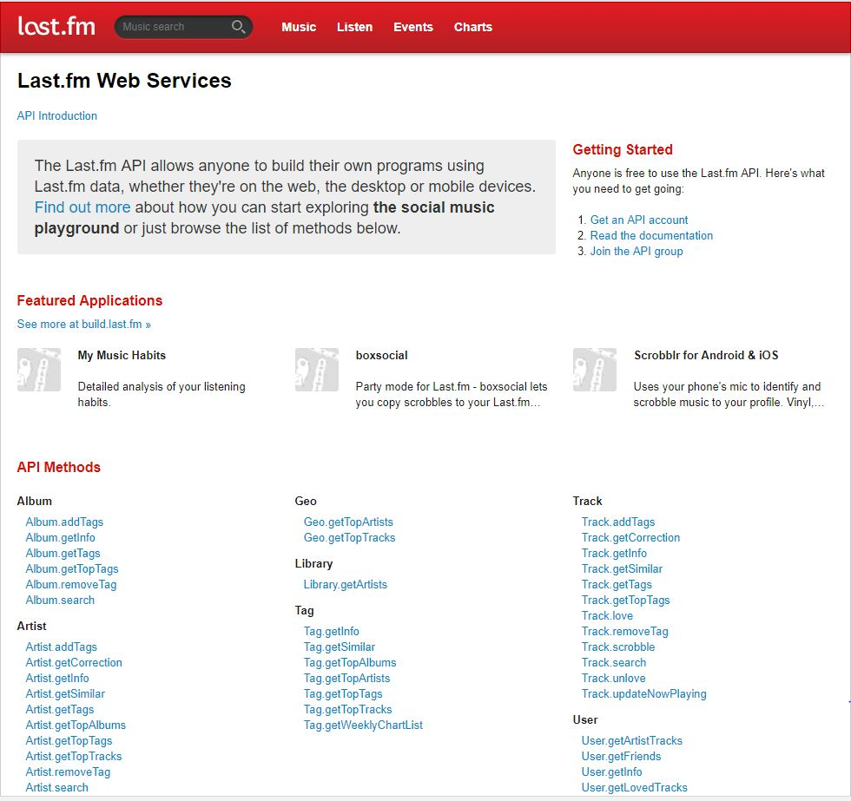
JS: Retrieve titles from LastFM
https://www.last.fm/api/show/artist.getTopTracks

Slide 10
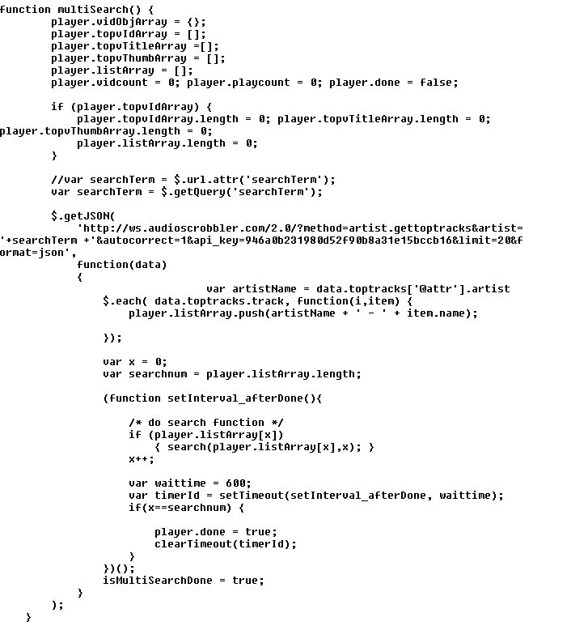
JS: Retrieve titles from LastFM
multiSearch sends AJAX web call to LastFM API with search term as parameter
This example uses artist.gettoptracks but many other API methods available
Each item in response list (ie; each song title with artist prefixed) is passed as a parameter to the search function.

Slide 11
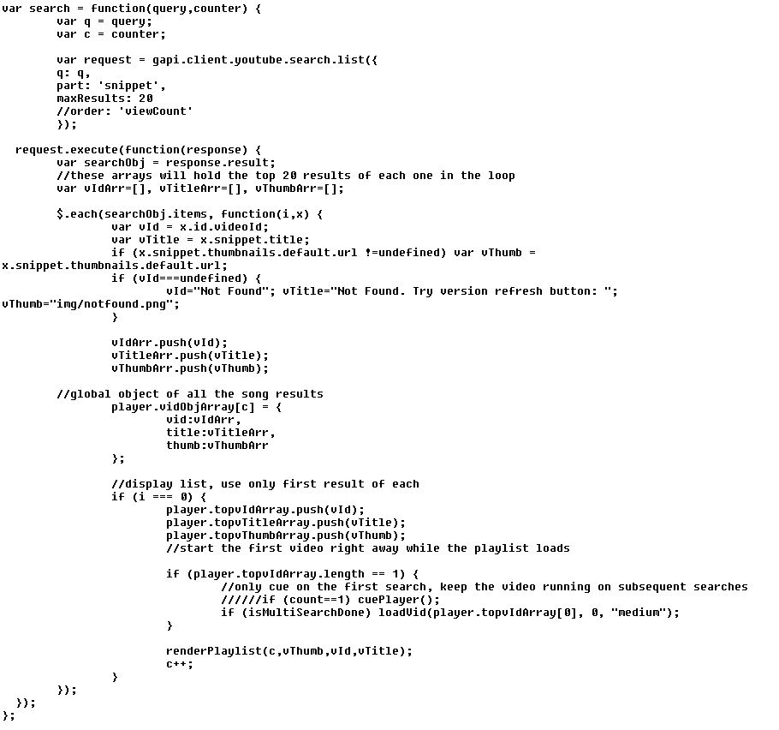
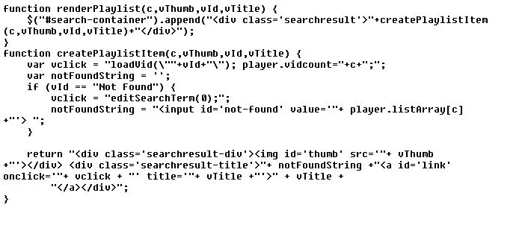
JS: Search YouTube Data API
The search function finds the top result on YouTube for each song title
Each result is rendered as a playlist item with title name + screenshot, and queued for playback

Slide 12
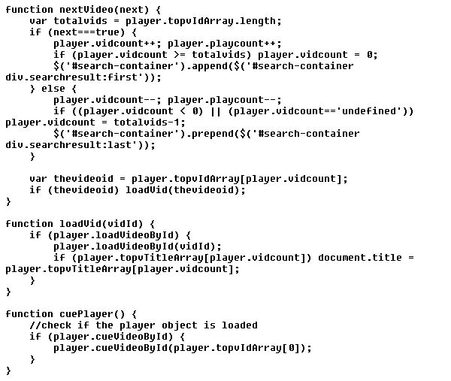
JS: Configure player behavior

Slide 13
Hardware

Slide 14
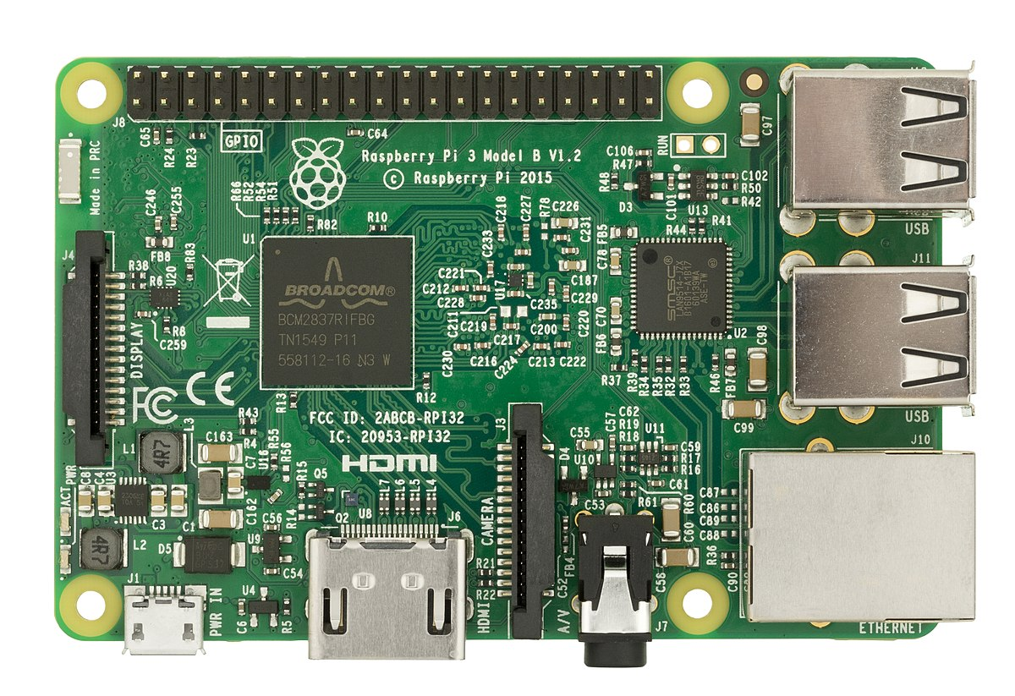
Raspberry Pi

Slide 15
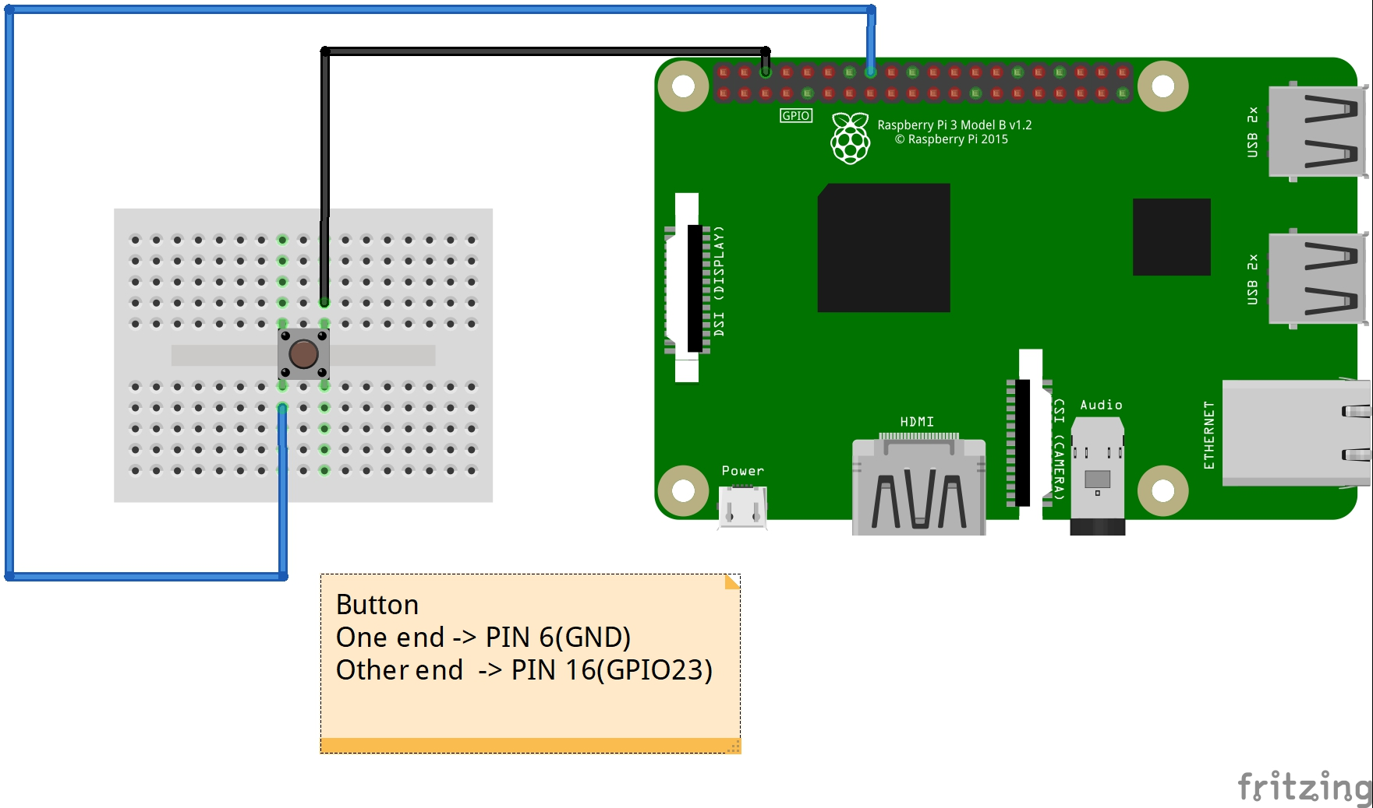
The Circuit Diagram

Slide 16
Python Scripting

Slide 17
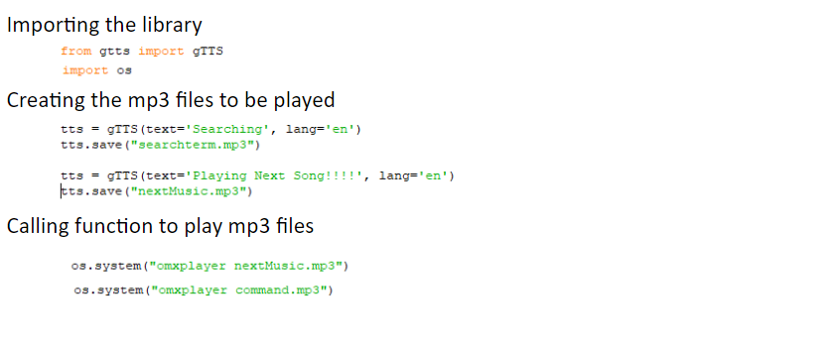
Generating MP3’s & Google Speech to Text (gTTS)

Slide 18
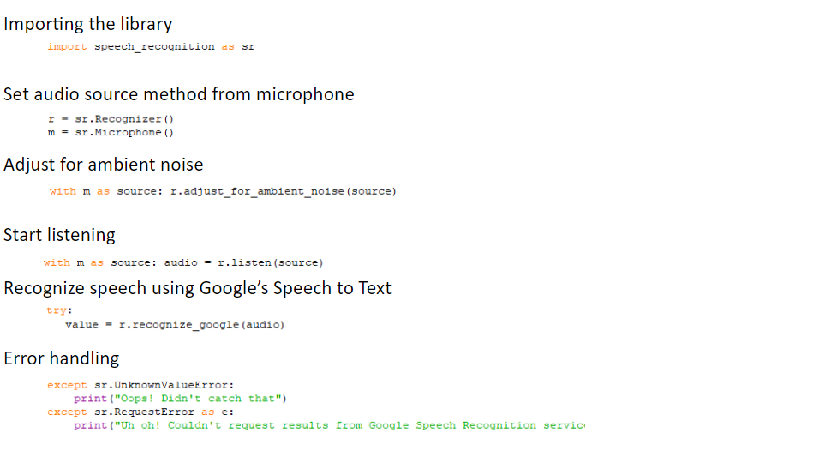
Speech_Recognition (Speech to text library)

Slide 19
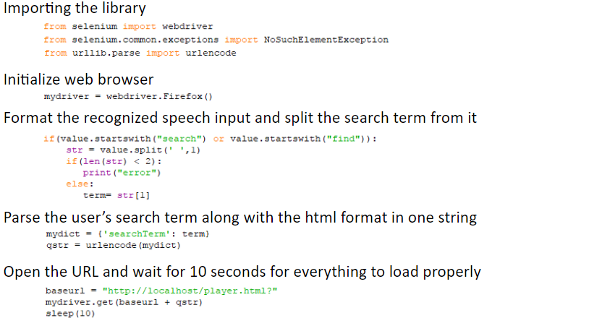
Selenium Library to control webpage & URL Parser

Slide 20
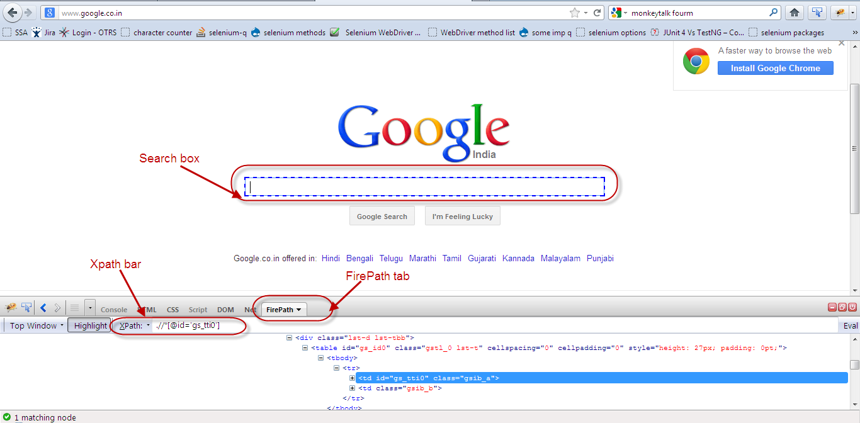
Selenium – finding the Xpath
Find the Xpath of an element on a website

Slide 21
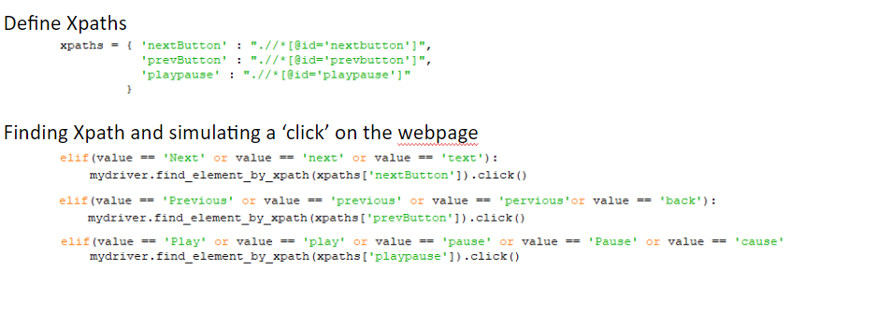
Selenium – finding the Xpath (Cont’d)

Slide 22
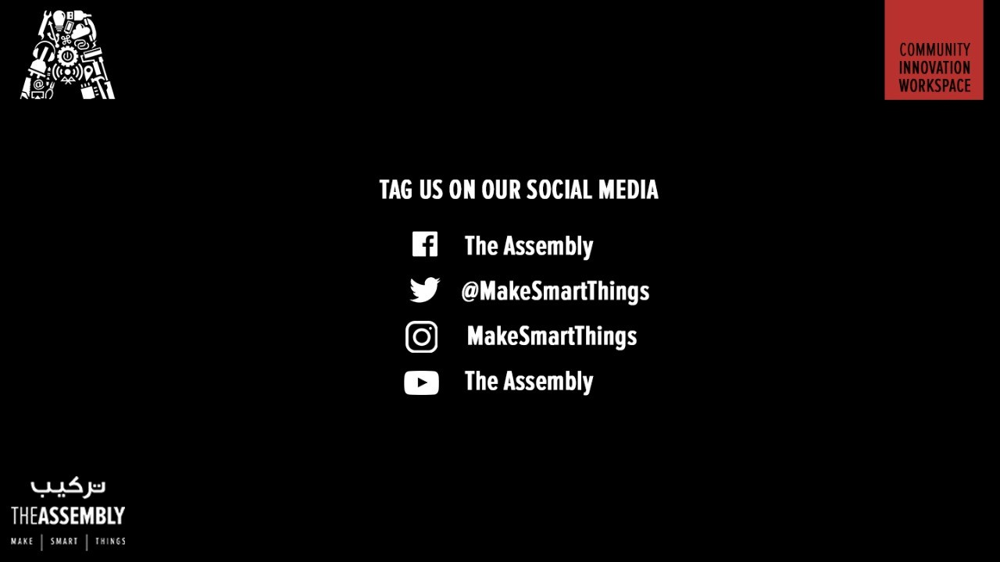
THANK YOU
THANK YOU

